Slide 1
Data-driven materiality analysis
Powered by Datamaran
Materiality assessment
workshop of COMPANY / DIVISION / STAKEHOLDER PANEL
Customer success team
September 2019

Slide 2
Table of content
Typical agenda
Template #1 - Context and presentation of the approach
Template #2 - Critical review of the first list of issues
Template #3 - Discussion on the External prioritization of issues
Template #4 – Strategic prioritization of issues

Slide 3
Typical agenda
A typical agenda for a Materiality assessment workshop is:
Note:
If you involve internal decision makers, it is interesting to show them the result of the external prioritization based on Datamaran data and eventually stakeholders consultation(s) you conducted for your materiality assessment
If you organize a workshop or a panel with a few of your direct stakeholders, it is interesting to have them prioritize or short-list the most important issues according to them and to capture their comments on their choice
5 min Introduction of the participants
10 min Context and presentation of the approach
20 min Critical review of the first list of issues (based on the issues mapping)
30 min Discussion on the External prioritization of issues (resulting from Datamaran)
30 min Strategic prioritization of issues (with Datamaran issues rating tools)
10 min Conclusions and next steps

Slide 4
Four templates to lead a workshop
Here are the four templates that you can use, based on Datamaran Materiality module, to lead a workshop:
Template #1 - Context and presentation of the approach
Template #2 - Critical review of the first list of issues
Template #3 - Discussion on the External prioritization of issues
Template #4 – Strategic prioritization of issues

Slide 5
Four templates to lead a workshop
Template #1 - Context and presentation of the approach
Template #2 - Critical review of the first list of issues
Template #3 - Discussion on the External prioritization of issues
Template #4 – Strategic prioritization of issues

Slide 6
What is Datamaran?
Datamaran combines Artificial Intelligence, big data analysis and human expertise, so you can capture
evidence-based insights into the strategic, regulatory and reputational risks
tied to 100 non-financial issues – more quickly and reliably.
Input (sources)
Scope (topics)
Output (ranking)
Environmental
Corporate reports
Global Regulatory initiatives
Geopolitical
Social
100+ non- financial issues
Social Media
Online News
Materiality matrix
Summary score table
Raw underlying data
Technological
Governance
Stakeholder surveys

Slide 7
Data driven materiality analysis
Compilation
Integration of Datamaran sources results and custom data from surveys, workshops or other sources
Corporate reports
Identification of peers’ priority topics (based on the level of emphasis per topic found in their reports)
6
1
Regulations
Assessment of the most regulated topics relevant to your operations/ jurisdictions:
Hard law (mandatory initiatives)
Soft law (voluntary initiatives)
(based on the number of tags per topic throughout the regulations)
External and internal stakeholder engagement
Interviews, workshops or surveys
depending on the chosen approach
5
2
4
3
Social media
Assessment of topics most covered on Twitter
(based on the number of tags per topic throughout the universe of tweets)
Online news
Assessment of topics most covered in the news for your sector
(based on the number of tags per topic throughout the universe of articles)
‹#›

Slide 8
Materiality analysis: process
External stakeholder view: based on Datamaran data
Databases: Corporate reports, Regulations, Online news, Social media
Definition of sources’ scope
Topics mapping
Results compilation and analysis
Integration in external view
Y-Axis
Presentation of the Matrix to an internal decision-making body
Internal stakeholder view: based on custom data, workshops, interviews or internal surveys
Definition of the approach
Workshop or interviews scheduling or survey set up
Carrying out and analysis of the results
Integration in internal view
X- Axis
Customize based on your own process
‹#›

Slide 9
Explanation of Datamaran sources’ scope
List of companies included in the Benchmark
Voluntary and mandatory regulation - List of countries included in the Regulatory analysis
Newsflow: List of industries included
Social media (Twitter): Global data
Copy and paste the accurate data, based on the choices you made when working on your materiality analysis

Slide 10
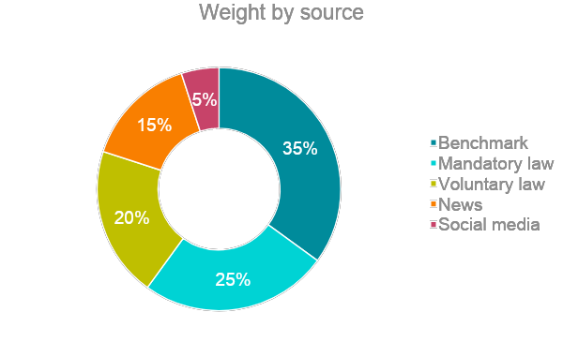
Breakdown of sources weight
A specific weight was applied to the scores retrieved for each source in order to refine the results.
Breakdown of sources’ contribution to the overall results:
Explanation of the choices:
Update the chart
Explain why you chose to add or remove weight to a source

Slide 11
Compilation and of the results
VERTICAL AXIS: Importance to external stakeholders
HORIZONTAL AXIS: Internal importance
All results were normalized to get a 0 to 1 score that allows to combine results from the different sources (level of emphasis for peers’ reports, number of tags for regulations, news and tweets and internal ranking).
1
EXTERNAL: Importance to external stakeholders
0
1
0
INTERNAL: Importance to the company

Slide 12
Four templates to lead a workshop
Template #1 - Context and presentation of the approach
Template #2 - Critical review of the first list of issues
Template #3 - Discussion on the External prioritization of issues
Template #4 – Strategic prioritization of issues

Slide 13
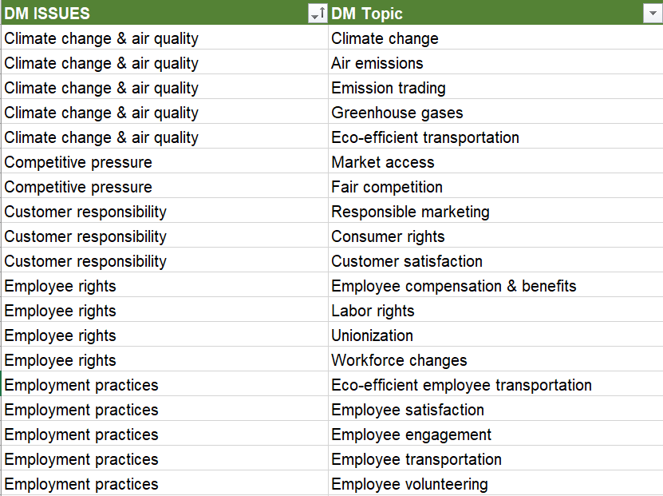
Critical review of the first list of issues
Show the issues and their underlying topics
Option 1- Use Datamaran default mapping Excel file

Slide 14
Critical review of the first list of issues
Show the issues and their underlying topics
Material issues | Datamaran Topic
Climate change & air quality | Air emissions
 | Climate change
 | Emission trading
 | Greenhouse gases
Competitive pressure | Fair competition
 | Market access
Customer responsibility | Consumer rights
 | Customer privacy & information security
 | Customer satisfaction
 | Responsible marketing
Digitalization | Digitalization
Employee rights | Employee compensation & benefits
 | Labor rights
 | Unionization
 | Workforce changes
Employment practices | Employee engagement
 | Employee satisfaction
Energy efficiency | Alternative fuels
 | Energy reduction & efficiencies
 | Energy use
 | Renewables & alternatives
Ethics & compliance | Anti-corruption & bribery
 | Business ethics
 | Reputation
 | Responsible tax practices
Fair and inclusive workplace | Fair remuneration
 | Workforce diversity & inclusion
Geopolitical events | Disaster management, recovery & relief
 | Geopolitical risk
Material issue | Datamaran Topic
Natural capital | Biodiversity
 | Forests
 | Land
 | Materials management
Pollution | Harmful substances
 | Water pollution
Product responsibility | Product stewardship
Responsible investment | Impact investing products
 | Responsible investment & financing
Responsible supply chain | Responsible procurement
 | Supply chain management
Solvency and economic value | Long-term value
 | Solvency and financial management
Talent & development | Employee attraction & retention
 | Employee development
 | Skilled workforce
Transparency | Executive compensation
 | Investor relations
 | Non-financial accounting
 | Public policy practices
Waste management | Hazardous waste
 | Non-hazardous waste
 | Recycling, waste management & reduction
Water | Water recycling, efficiencies & remediation
 | Water resources
Wellbeing, health & safety | Corporate culture
 | Employee wellbeing
 | Occupational health & safety
Option 2 - Build your own table

Slide 15
Critical review of the first list of issues
Show the issues and their underlying topics
SOCIAL
SOCIETAL
ENVIRONMENTAL
ECONOMICAL
Employee rights
Geopolitical events
Climate change & air quality
Digitalization
Option 3 – Present the issues according to your CSR pillars
Employment practices
Human rights
Energy efficiency
Ethics & compliance
Fair and inclusive workplace
Inclusion & accessibility
Natural capital
Governance
Talent & development
Local community support
Pollution
Innovation & research
Wellbeing, health & safety
Support for entrepreneurs
Waste management
Product responsibility
Youth inclusion
Water
Responsible supply chain

Slide 16
Critical review of the first list of issues
Typical questions to ask the workshop participants:
Do you need clarification for any of the issues?
According to you is there any issue missing in the list? Why?
Is there any issue that you are suprised to see in the list? Why?
To facilitate the discussion make sure to provide a readable list to the participants, including the definitions of the issues

Slide 17
Four templates to lead a workshop
Template #1 - Context and presentation of the approach
Template #2 - Critical review of the first list of issues
Template #3 - Discussion on the External prioritization of issues
Template #4 – Strategic prioritization of issues

Slide 18
Discussion on the External prioritization of issues
Show the external ranking as produced by the module

Slide 19
Discussion on the External prioritization of issues
Typical questions to ask the workshop participants:
Comment the assessment of importance to the stakeholders based on Datamaran’s source (External axis) – given your understanding of the issues and external expectations:
Individually: Review the ranking and identify the issues that you think should be ranked lower or higher
In group: Share the identified issues with other participants, explain the reasons why they are more or less important from an external point of view. Other participants react.
Conclusion: Short-list the issues on which there is a consensus that the ranking should be fine-tuned and the additional sources of information to take into account.

Slide 20
Four templates to lead a workshop
Template #1 - Context and presentation of the approach
Template #2 - Critical review of the first list of issues
Template #3 - Discussion on the External prioritization of issues
Template #4 – Strategic prioritization of issues

Slide 21
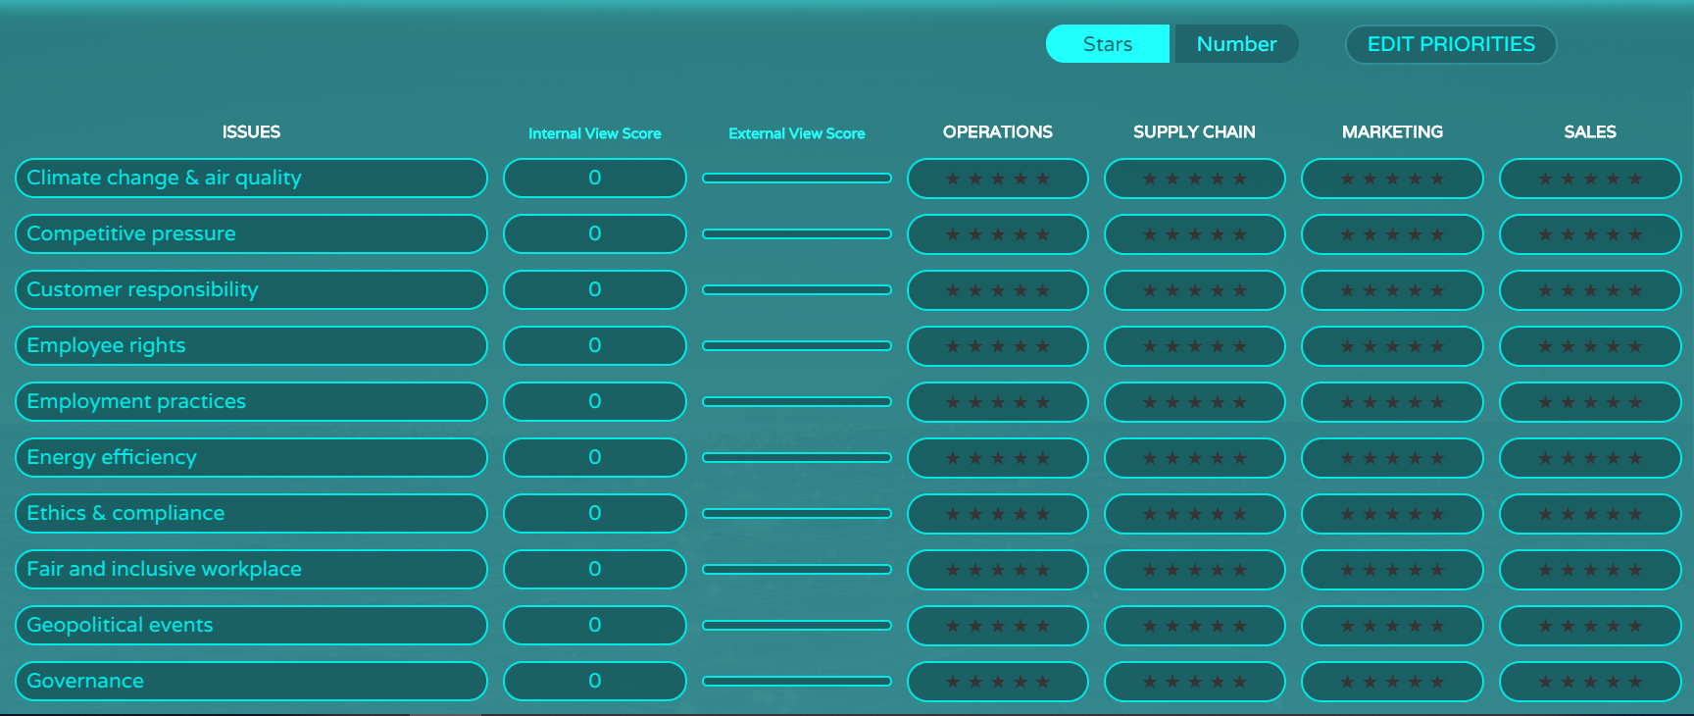
Template #4 – Strategic prioritization of issues
Copy and paste the ranking tools in the Internal view or show Datamaran during your meeting

Slide 22
Discussion on the External prioritization of issues
Typical questions to ask the workshop participants:
Based on your understanding of the company’s strategy and the risks / opportunities associated to the issues, what is the importance of the following issues for the company?
Individually: Review again the list and make your assessment based on the ranking methodology chosen (ideally before the meeting).
In group: Share most important issues with other participants, explain the reasons why. Other participants react.
Conclusion: Confirm the ranking of importance or identify the issues for which the importance should be fine-tuned based on additional sources of information or the involvement of other internal decision-markers or experts.

